Slide 1
HCL JIGSAW
ROUND 2 · SIMULATION PRESENTATION
Traffic Flow Optimizer
Grade 8 · AI Revolution & Digital Futures
CONTEXT
YOUR CHALLENGE
Traffic jams at busy junctions in tier-2 cities waste fuel and time and add to pollution. Most signals run on fixed timers, whatever the traffic.
Show us your AI traffic model for one 4-way intersection in your city, and how much better it does than a fixed-timer signal.
6 questions · 3 screenshots (intersection, simulation, results) + a link · Answer every question in your own words
HCL JIGSAW | Edition 7 | Grade 8 · AI Revolution & Digital Futures | Round 2 · Simulation Presentation

Slide 2
HCL JIGSAW
Traffic Flow Optimizer · Round 2
BEFORE YOU START · TEAM & MODEL DETAILS
Tell us who you are and which intersection you studied
Share a link to your simulation or data model (Scratch, Google Sheets, etc.) that opens for anyone without logging in.
Team name
School & city
team_965_0045
PACIFIC WORLD SCHOOL , Greater Noida
team_965_0045
Team members (name – role)
Link to our simulation / model
Chiranjeet Sahoo – Team Coordinator Aarav Nagar – Team Designer
Ayan Ali -
Anant Yadav-
Type your answer here…
Our traffic data is…
☐ Real counts (we counted vehicles safely)
Ek Murti Chowk, near Pacific World School, Greater Noida West
☑ Simulated / estimated data
Intersection we studied
HCL JIGSAW | Edition 7 | Grade 8 · AI Revolution & Digital Futures | Round 2 · Simulation Presentation
2

Slide 3
HCL JIGSAW
Traffic Flow Optimizer · Round 2
STEP 1 · THE PROBLEM
Q1. What problem does your model solve, and who will use it?
Which intersection, what happens there at peak time, how the signal works today, what it costs people, and who would use your system.
Study area: Ek Murti Chowk, near Pacific World School, Tech Zone IV, Greater Noida West. The school’s published address places it near Ek Murti Chowk.
Problem to investigate: during school arrival and dispersal, school vehicles, private cars, two-wheelers and other commuters may approach the area at different rates. If queues build unevenly at a nearby signal-controlled junction, equal green times may not suit every approach.
Our model: Ek Murti Chowk is a roundabout, so this spreadsheet uses a simplified four-approach signal scenario inspired by the school’s local area; it does not claim that the roundabout currently uses a fixed-timer signal. Traffic counts are simulated, not measured. Intended users are traffic police and traffic engineers evaluating timing plans before any real-world trial.
HCL JIGSAW | Edition 7 | Grade 8 · AI Revolution & Digital Futures | Round 2 · Simulation Presentation
3

Slide 4
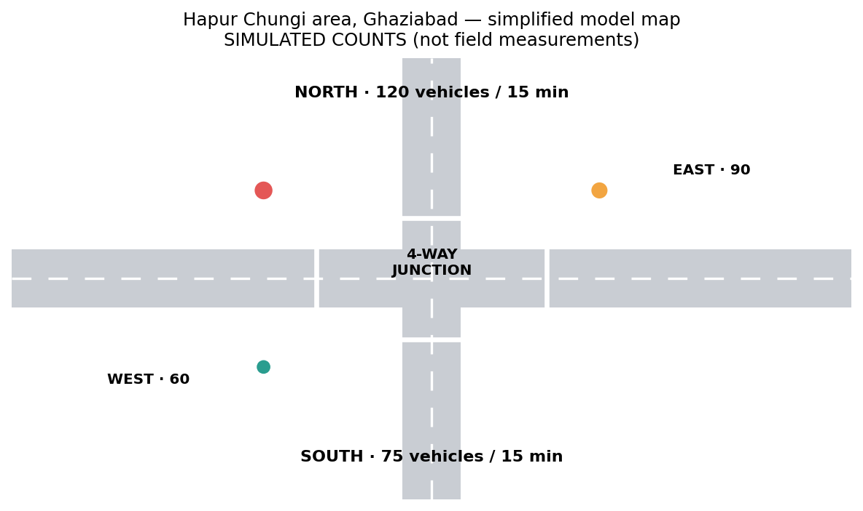
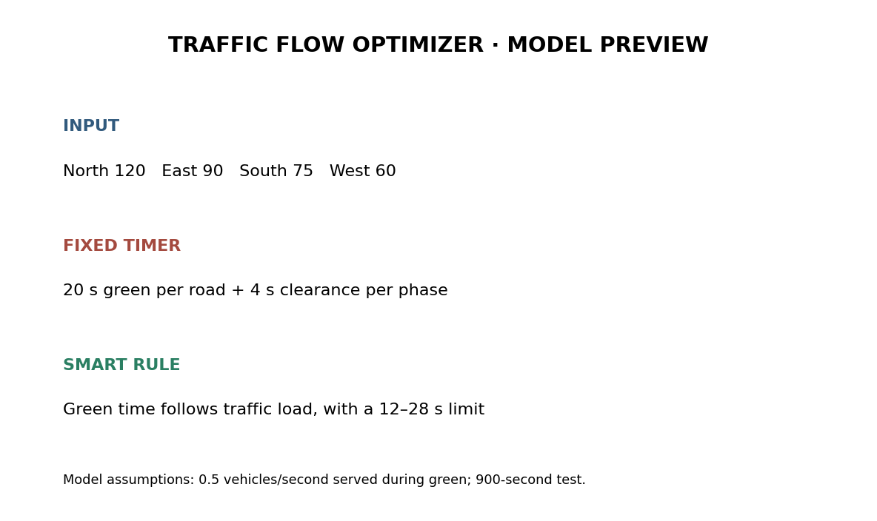
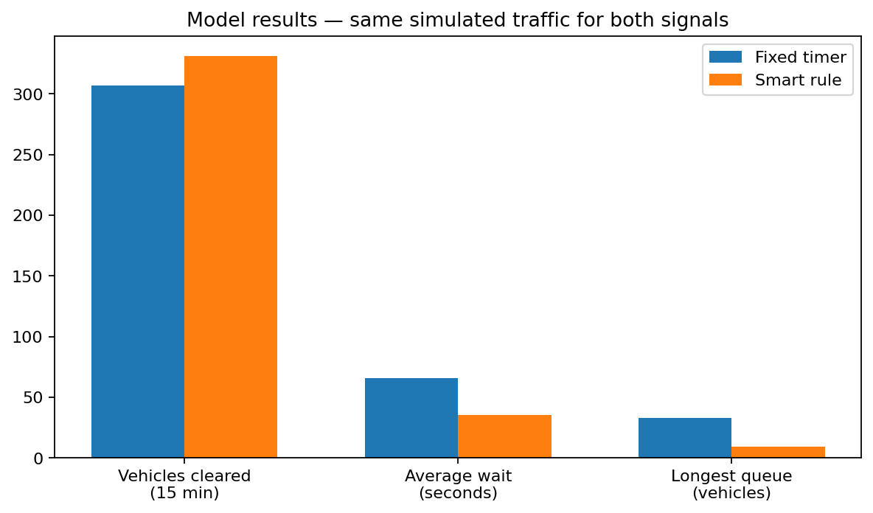
HCL JIGSAW
Traffic Flow Optimizer · Round 2
STEP 2 · SHOW YOUR MODEL
Q2. Show your intersection, your simulation and your results
Add 3 screenshots: a labelled map of the junction with traffic counts, your simulation running, and a chart comparing fixed vs smart signals.
INTERSECTION
SIMULATION
RESULTS
Simplified four-approach model for the area near Ek Murti Chowk and Pacific World School; simulated counts only.
Model preview: same arrivals tested under fixed and smart green times.
Results chart compares vehicles cleared, average wait and longest queue.
HCL JIGSAW | Edition 7 | Grade 8 · AI Revolution & Digital Futures | Round 2 · Simulation Presentation
4

Slide 5
HCL JIGSAW
Traffic Flow Optimizer · Round 2
STEP 3 · HOW IT WORKS
Q3. Explain how your smart signal works, step by step
COUNT: how does it know the traffic on each road? DECIDE: how does it work out green time? SWITCH: how does it change signals safely?
1 · COUNT
➜
2 · DECIDE
➜
3 · SWITCH
COUNT:
We enter simulated 15-minute counts for North, East, South and West. In a real system, cameras or sensors could count vehicles at stop lines; counts must be checked and privacy protected.
DECIDE:
Give busier approaches more green time, with a 12–28 s limit. North has 120 simulated vehicles, so it gets 28 s; West has 60, so it gets 13 s. Smart greens total 80 s, matching the fixed plan.
SWITCH:
After green, allow 4 s of clearance in this simplified model. Use yellow then all-red before the next road; never allow conflicting greens. If counts fail, revert to a safe fixed plan. Emergency priority needs verified detection and approved safety rules.
HCL JIGSAW | Edition 7 | Grade 8 · AI Revolution & Digital Futures | Round 2 · Simulation Presentation
5

Slide 6
HCL JIGSAW
Traffic Flow Optimizer · Round 2
STEP 4 · YOUR TRAFFIC DATA
Q4. Show your traffic counts and the green times for each road
One row per road. Compare the fixed timer with your smart signal. Then say where and when the data came from.
Road (direction) | Vehicles per 15 min (peak/simulated) | Fixed-timer green (s) | Our smart green (s)
North approach | 120 | 20 | 28
East approach | 90 | 20 | 22
South approach | 75 | 20 | 17
West approach | 60 | 20 | 13
Data: where, when & how | Simulated, not field-counted. Pacific World School is near Ek Murti Chowk; this is a simplified four-approach signal scenario, not a model of the roundabout’s current control. Test input = 345 vehicles/15 min. Both plans use 80 s total green and 4 s clearance per approach.
HCL JIGSAW | Edition 7 | Grade 8 · AI Revolution & Digital Futures | Round 2 · Simulation Presentation
6

Slide 7
HCL JIGSAW
Traffic Flow Optimizer · Round 2
STEP 5 · TEST & IMPROVE
Q5. How much better is your smart signal than a fixed timer?
Run the same traffic through both. Compare vehicles cleared, average wait and longest queue. Note what you changed and the limits.
Our results: fixed vs smart
What we changed & limitations
Same simulated arrivals over 15 minutes:
• Vehicles cleared: 307 fixed vs 331 smart
• Estimated hourly equivalent: 1227 vs 1323 (15-minute result × 4; projection only)
• Average waiting time: 65.6 s vs 35.1 s (46.5% lower)
• Longest queue: 33 vs 9 vehicles (72.1% lower)
These are outputs of our simplified simulation, not real-world measurements.
WHAT WE CHANGED
We kept the same 80 seconds of green time and shifted more of it toward the busier North and East approaches.
LIMITATIONS
Counts are simulated; vehicle arrivals are spread evenly over 15 minutes; discharge is assumed to be 0.5 vehicles/second; turning movements, pedestrians, lane differences and incidents are not modelled. Results need field testing before real use.
HCL JIGSAW | Edition 7 | Grade 8 · AI Revolution & Digital Futures | Round 2 · Simulation Presentation
7

Slide 8
HCL JIGSAW
Traffic Flow Optimizer · Round 2
STEP 6 · WHY IT'S WORTH IT
Q6. Why should the city traffic police try it?
Turn your results into benefits (time, fuel, pollution), say what the police need to try it, then write a 3-line pitch to the traffic police.
Benefits in numbers
Our 3-line pitch to the city traffic police
Average wait: 65.6 s → 35.1 s (46.5% lower).
About 2.93 vehicle-hours of waiting avoided in this 15-minute scenario.
Illustrative estimate only: ~1.76 L fuel and ~4.0 kg CO₂, using stated idle-fuel assumptions—not measured savings.
Please help us test a smarter signal that gives green time according to traffic demand.
Our simulated model reduced average waiting and the longest queue using the same total green time.
We request a small, supervised pilot with real data before any wider rollout.
What the police need to try it
1. Traffic engineers review the model and safety plan.
2. Collect supervised, privacy-safe traffic counts.
3. Simulate first; consider a short supervised pilot only if approved.
Cost: spreadsheet prototype is free; real sensors/signals need a separate city budget.
HCL JIGSAW | Edition 7 | Grade 8 · AI Revolution & Digital Futures | Round 2 · Simulation Presentation
8

Slide 9
HCL JIGSAW
Round 2 · Team Understanding Check
FINAL STEP · INDIVIDUAL UNDERSTANDING CHECK
Q7. Each member: explain our project in your own words
Write 3–4 sentences: (1) what problem we solve, (2) how our prototype solves it, (3) one thing YOU did or learned. Answer on your own – don't copy your teammates.
MEMBER 1
Chiranjeet Sahoo
MEMBER 2
Aarav Nagar
Our project studies how a traffic signal can respond to different queue sizes. We compare a fixed timer with a rule that gives more green time to busier roads. I worked on researching the problem and checking the assumptions. I learned that results must be tested with honest data.
Our prototype uses traffic counts to allocate green time across four approaches. The same simulated traffic is tested under both signal plans. I helped build the spreadsheet model and organise the inputs. I learned how a fair comparison keeps the traffic conditions the same.
MEMBER 3
AyAN ali
MEMBER 4
Anant Yadav
The problem is that equal green times may not suit unequal traffic demand. Our smart rule adjusts the split while keeping the total green time equal to the fixed plan. I helped test the results and prepare the chart. I learned that a model has limits and cannot replace real testing.
We designed a Traffic Flow Optimizer prototype for a busy Ghaziabad junction. It compares vehicles cleared, waiting time and longest queue. I helped prepare the presentation and pitch. I learned that a good AI idea must also include safety rules and clear evidence.
HCL JIGSAW | Edition 7 | Round 2 · Individual Understanding Check
9

